Slide 1
INTERNSHIP PROJECT PRESENTATION
BVDU-Amplify-DITM
Presented By- Abhik Rai
Roll number: bsit/15/021
Seat number: 1715390024

Slide 2
About the Company
Forbes Marshall

Slide 3
Forbes Marshall is an Indian engineering and energy conservation solutions provider, especially for the process industry.
Forbes Marshall makes steam engineering and control instrumentation products and solutions.
Its origins trace to a venture by J. N. Marshall and Darius Forbes in Pune in the 1940s, with a factory established at Kasarwadi, Pune in 1958.
In 2013, Forbes Marshall was voted one of India's top ten best companies to work for.
Forbes Marshall has four manufacturing units in India which are located at Kasarwadi, Pimpri, Hyderabad and Chakan near Pune.

Slide 4
Forbes Marshall is the leader in process efficiency and energy conservation for process industry.
Several of their products have received awards for innovation and energy saving.
Research and Development has always had an important role at Forbes Marshall. A central R&D department closely integrates its efforts into the operation of each division and has brought several innovations to the market.
Forbes Marshall has an annual turnover of 800cr.

Slide 5
Their Values
Forbes Marshall Family Support
Integrity
Innovation and Entrepreneurship
Value delivery to the Customers, Members and Society

Slide 6
The Project
Visitors management system

Slide 7
Overview
Current scenario- manual
Proposed process: automation by vms
Visitors scribbling on notebook at entry and exit.
Visitor pass without visitors details
No check on visitor entry/exit
Data reliability issues
Security concerns
No MIS
Complete automated system for managing visitors
No paper work
Customized visitors pass with visitor photo and details
MIS

Slide 8
Need of VMS to the company
To create appointment for the Visitors where the security can access them and provide a gate pass with the photo printed on it.
To issue work permits for doing contract jobs in factory premises.
The company had an existing visitors management system which they had purchased from a third party vendor but they were not happy with the system as there were a lot of useless functions in the application.
The company wanted a simple and customized application built according to their needs.

Slide 9
Technology and Associated Platform
The User Interface Design was created using Oracle Apex 4.2
The code was written in SQL and PL/SQL queries.
Oracle 10g was used for creating and storing the data in the database.

Slide 10
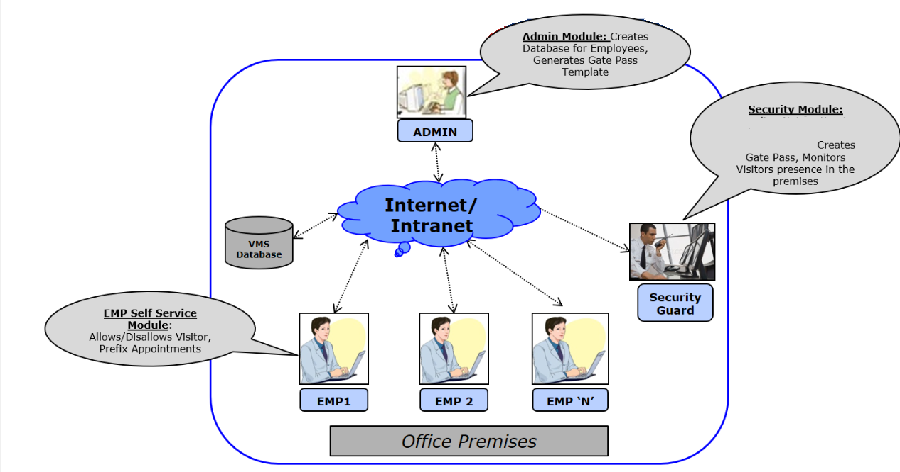
Architecture
Adds status, arrival time and picture.

Slide 11
Contribution to the Project
Created different usernames and passwords for logging in to the application for the Admin, Security and the company employee.
Created the database tables with the required fields.
Designed the U.I by firstly creating the tabs using conditions in SQL.
Created the pages and the text fields.
Wrote the PL/SQL code through which the details added by the admin, end user and the security are added or updated using the text fields and the details are stored and retrieved using the Oracle database.
Testing the validations and functions.

Slide 12
Working of the Application
The company employee creates an Appointment/Work permit.
This appointment will be seen by the security at the gate.
When the visitor arrives the security will check for his appointment and add the additional details like his status, arrival time and his photograph.
The security guard will then print his gate pass.
When the visitors work is done the security guard will update his status.

Slide 13
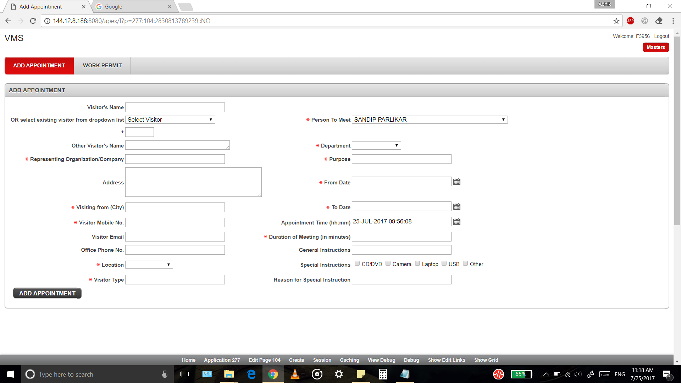
Screenshots of the Project
Adding Appointments

Slide 14
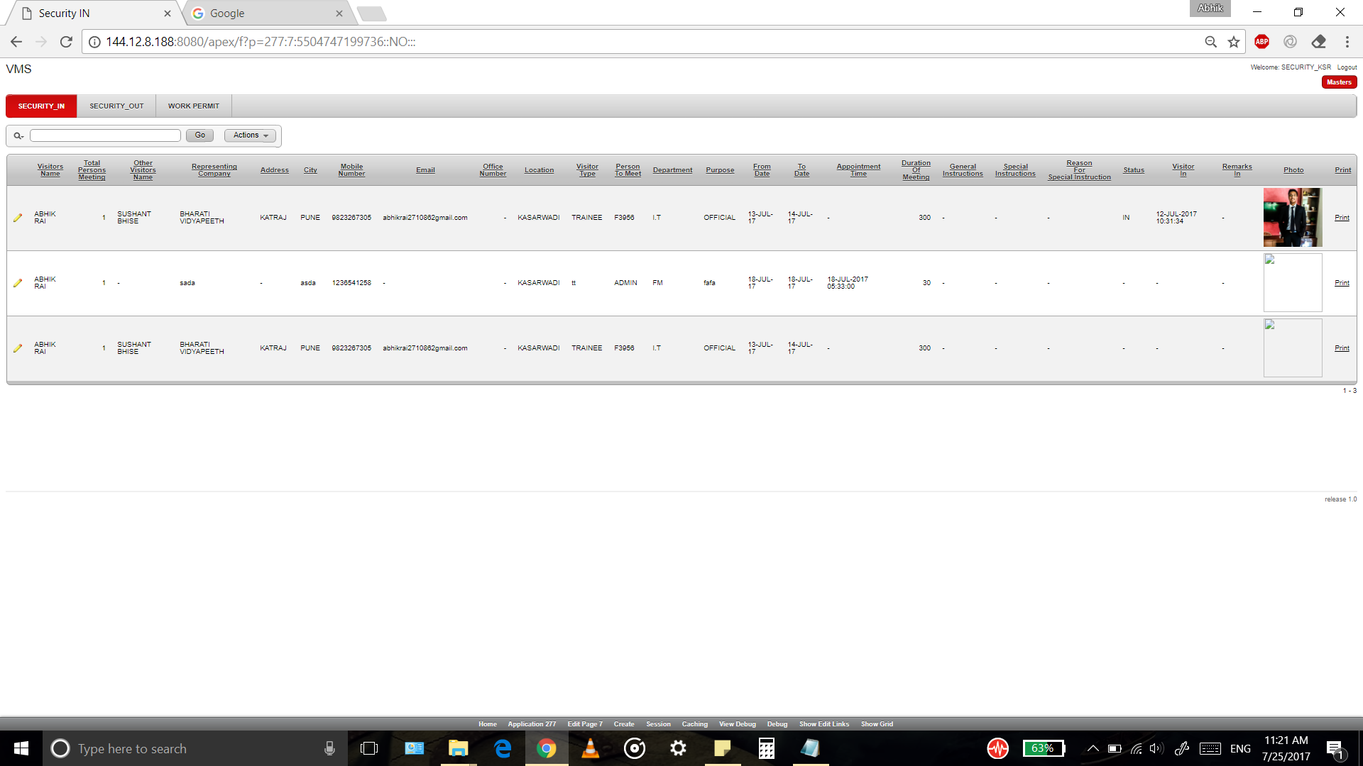
Security_IN tab

Slide 15
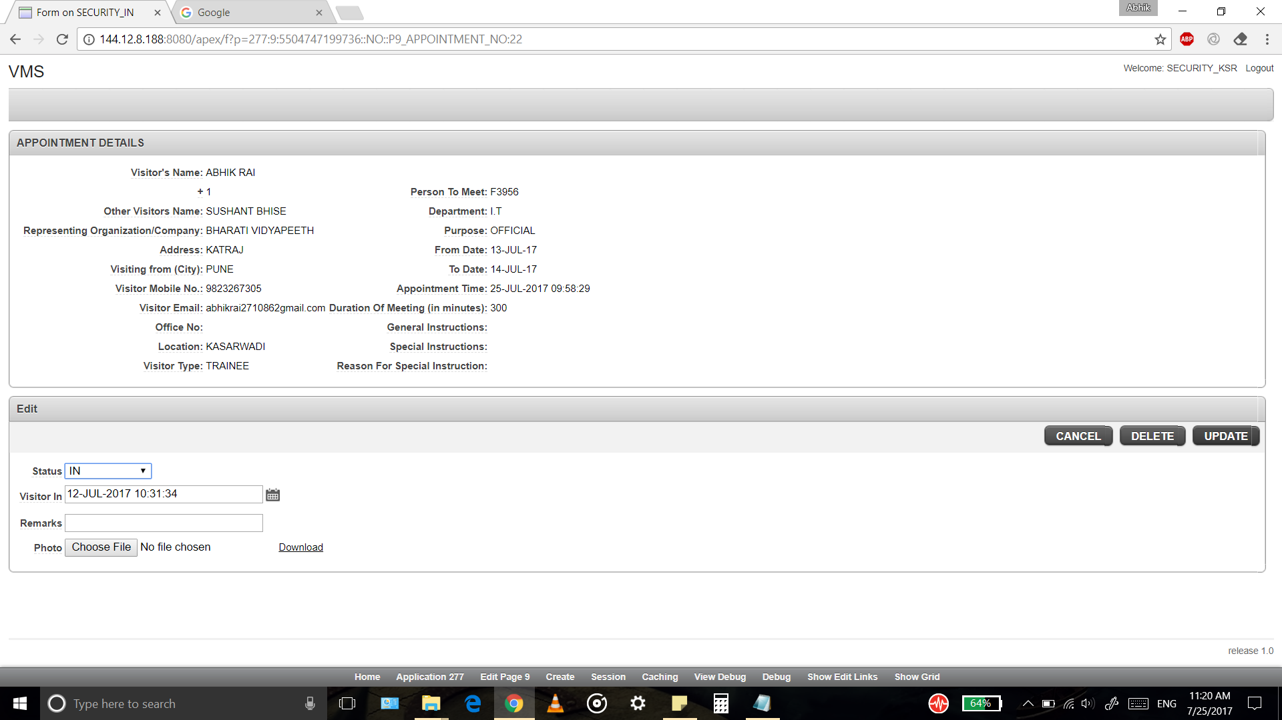
Updating Appointment details by the Security

Slide 16
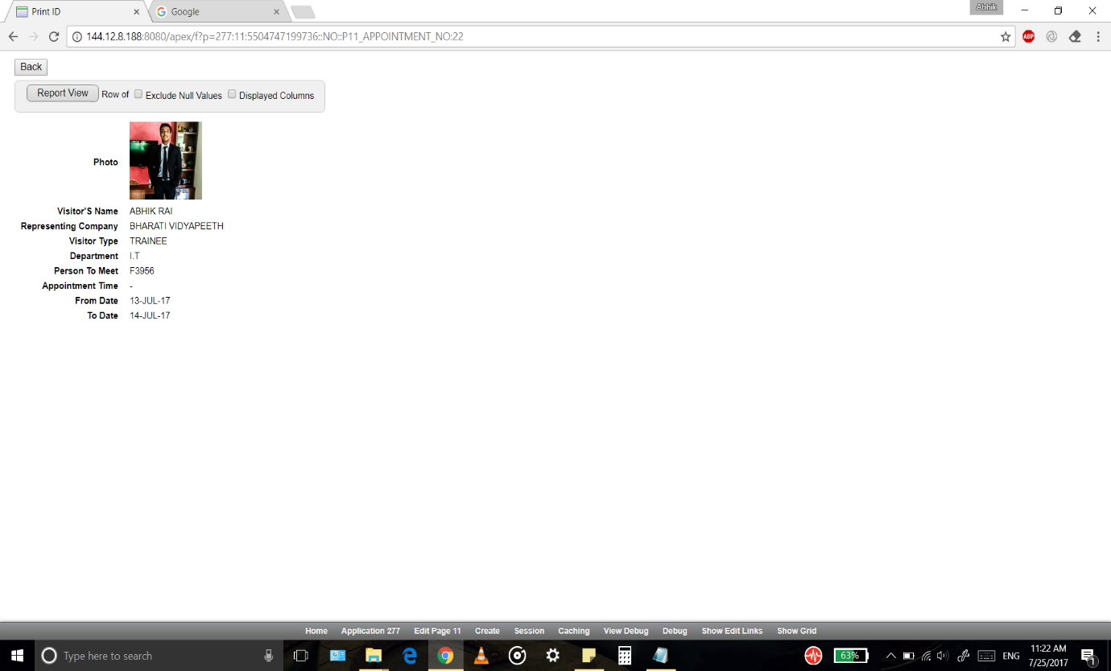
Gate Pass Print

Slide 17
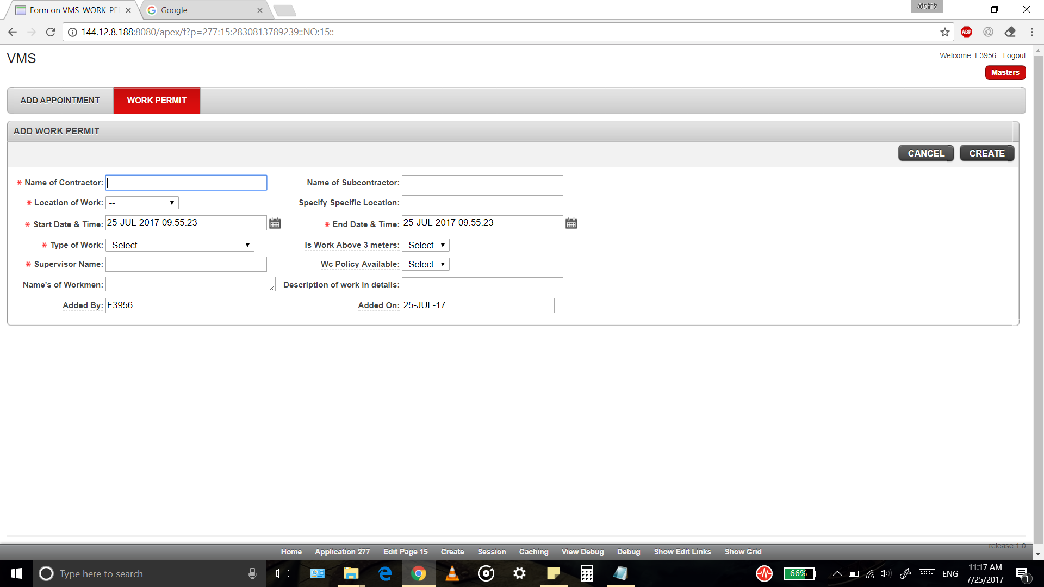
Adding Work Permit

Slide 18
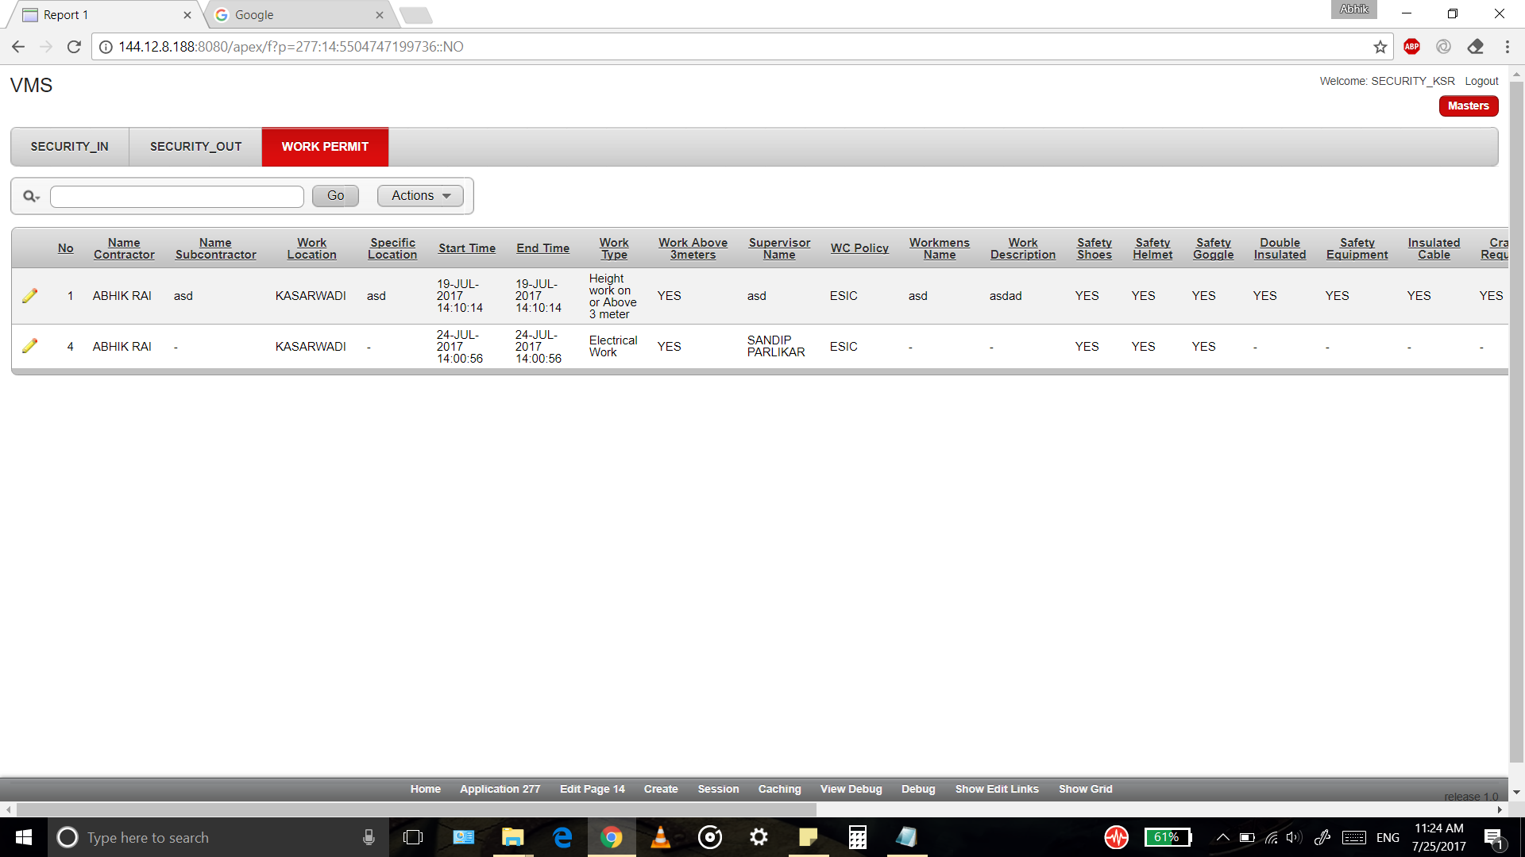
Work Permit Report

Slide 19
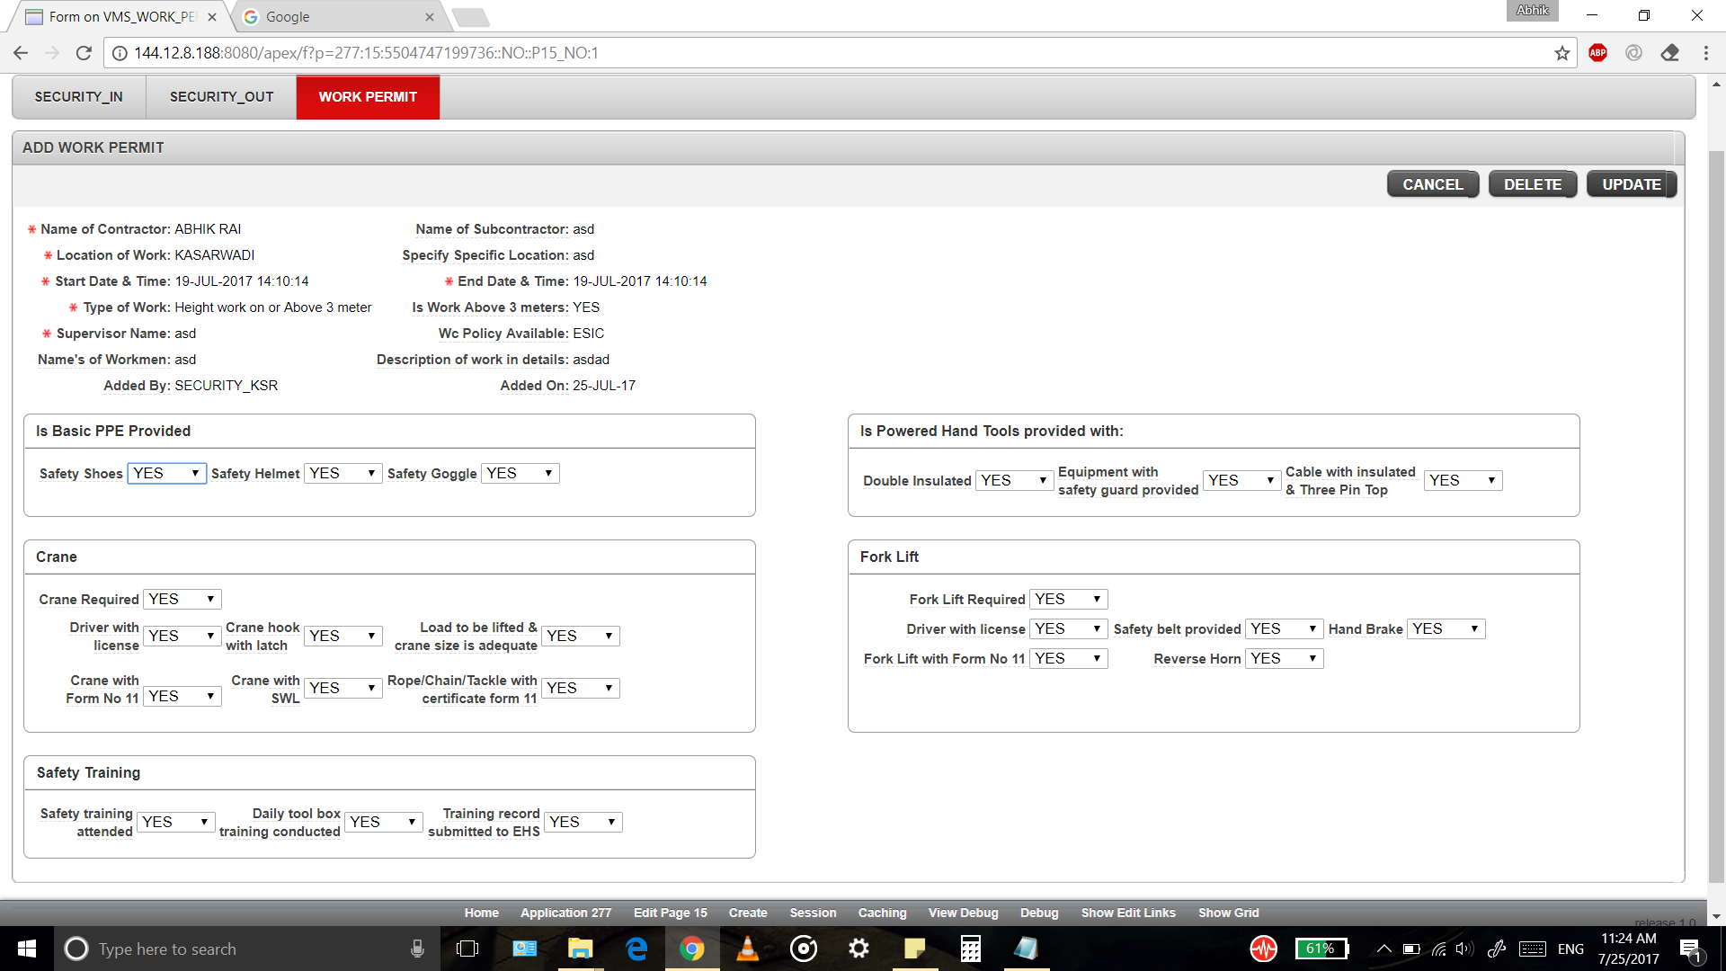
Updating Work Permit details by the Security

Slide 20
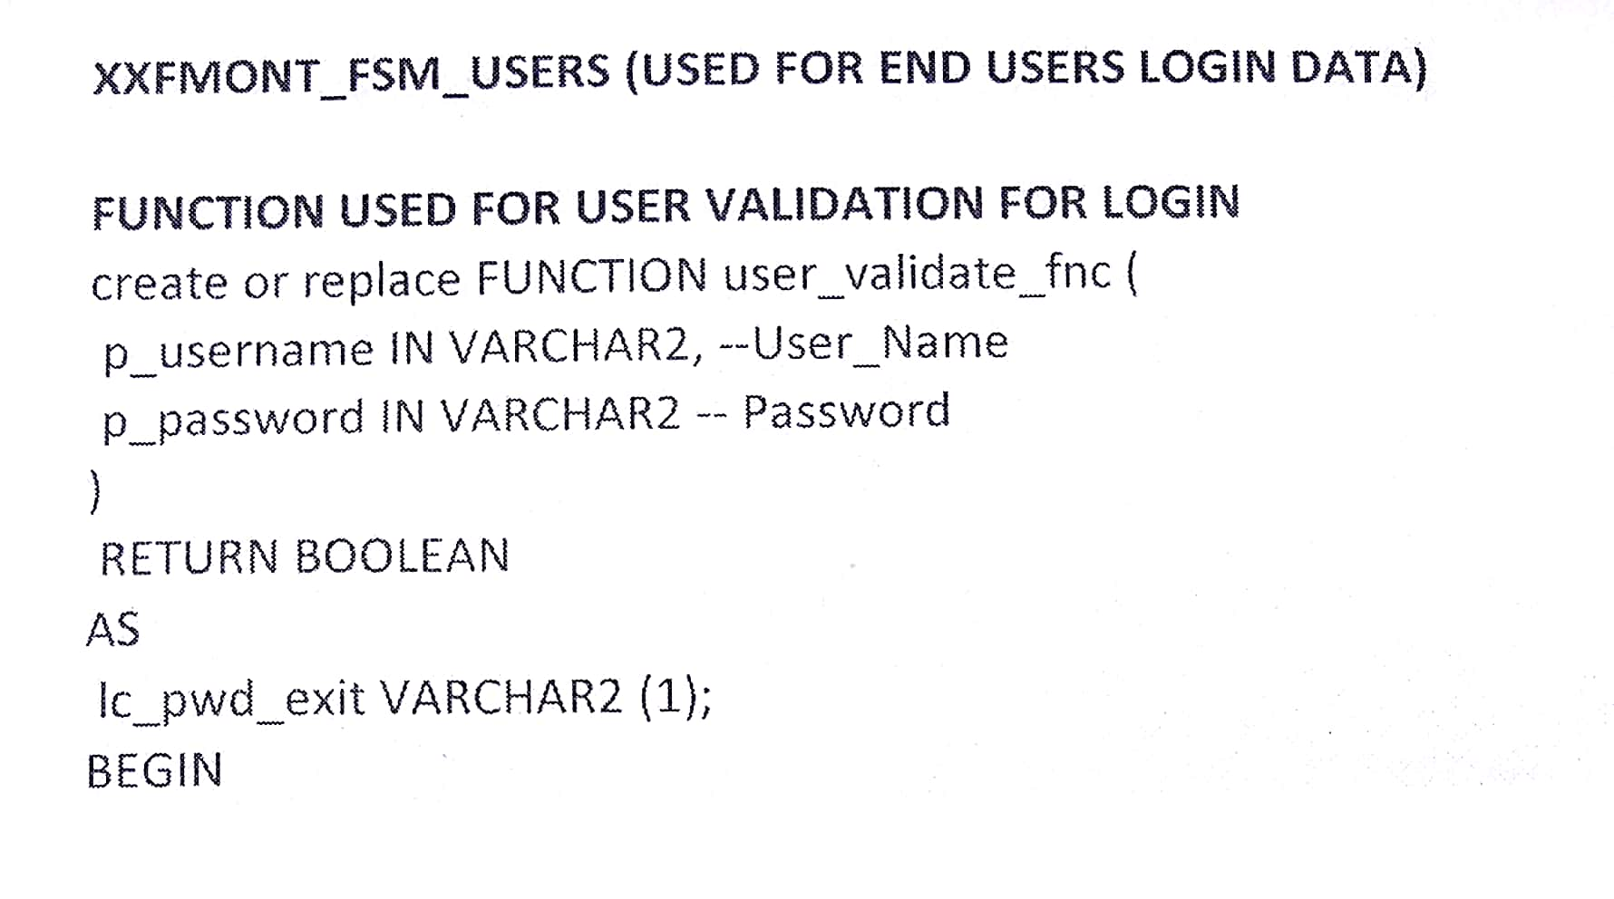
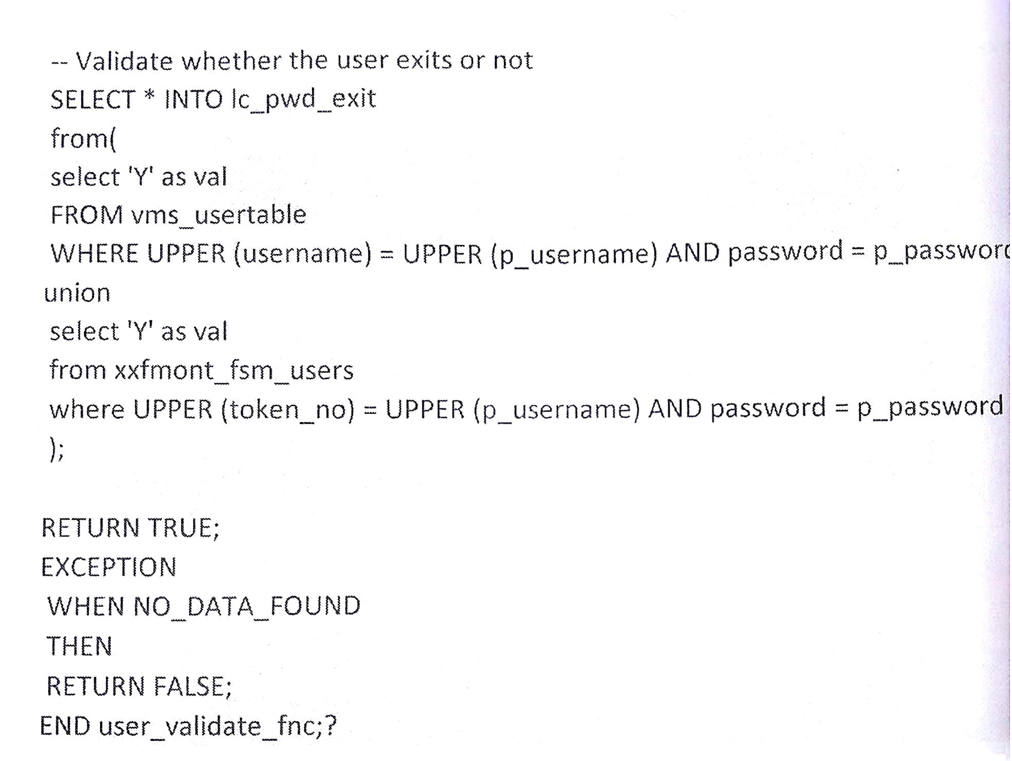
Code Snippet

Slide 21
Conclusion
During this internship I have learnt a lot of things which have helped me grow as a professional.
It was my first time working in a company environment which exposed me to the industry and educated me on how things are done in the industry. I learnt that planning and documentation are one of the key aspects of the whole development process.
In this internship I got an overview of the Oracle Apex Application and I got to know the importance of database in an organization.

Slide 22
THANK-YOU

